Slide 1
Felix N.
Felix Nunez
John Jay College of Criminal Justice
2019

Slide 2
Executive Summary
Goal of Analysis
Dataset Description
Key Observations
With enough information given to it, could a model predict whether a restaurant received a passing or failing grade on their inspection?
Venue Info:
Additional information on each restaurant, such as location and cuisine type
Violations:
Restaurant violation descriptions including dates and whether initial or reinspection
The violation descriptions contained invaluable information for the model that had to be reinterpreted from categorical data into something the model could quantify
Log Loss Error: 0.19404

Slide 3
Goal/Objective of Analysis
The goal of the analysis was to build a model that would take the given data, venue information and violations, and learn to predict a probability on whether the given restaurant passed or failed it’s inspection

Slide 4
Dataset Description
The data comes to us from NYC Department of Health
Four sets of CSV files (Comma-Separated Values)
inspection_train.csv - Main table for the competition, has restaurant ID’s, inspection date and type and whether it passed or failed
inspection_test.csv - Same as the training table without the passed or failed column. To be tested against
venues.csv - Information for individual restaurants, location and cuisine type
violations.csv - Violation descriptions based off of restaurant id and inspection date
Testing data spans from 07-01-2018 - 04-08-2019
While Training data spans from 10-07-2011 - 06-30-2018
Violations span from 10-07-2011 - 04-08-2019
The Camis is the key that connects all of the tables, being the restaurant ID
Violation Descriptions has a wealth of information

Slide 5
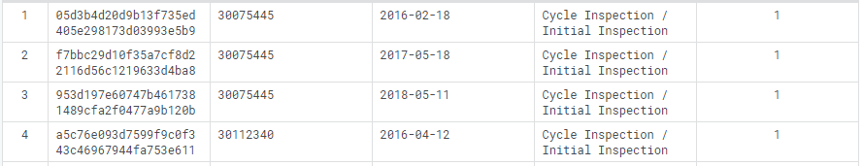
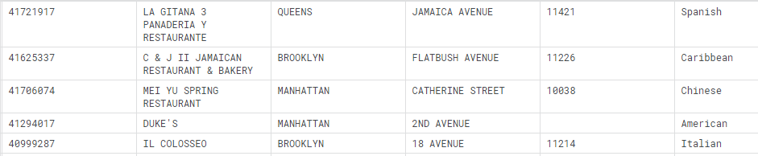
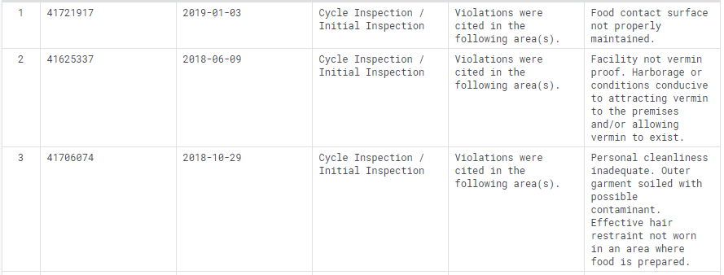
Data
inspection_train.csv
venues.csv
violations.csv

Slide 6
XGBClassifier
A part of the XGBoost Library, I chose the XGBClassifier as that is what I was using in the Kaggle learning module, and it has the predict_proba function that was necessary for the competition
I also used GridSearchCV in order to determine the best number of n_estimators, max_depth and learning_rate for the model to use
First though, I had to do some feature engineering...

Slide 7
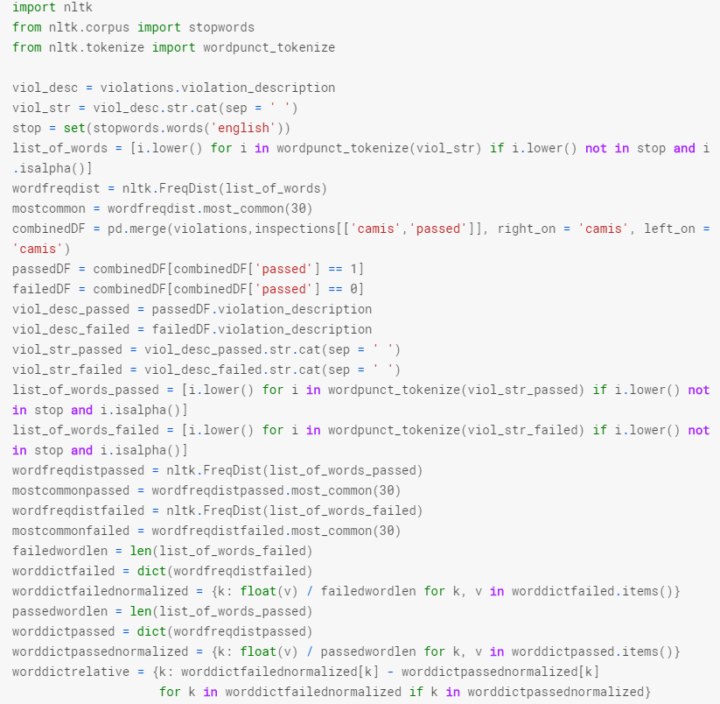
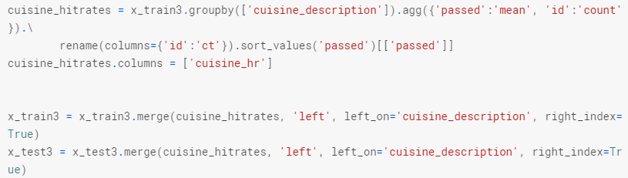
Given Code
Nick from Point72 was nice enough to give us some example codes that we could use and build upon. The Cuisine hit rate was used as a key feature by the model. I used the word cloud code to add a feature.

Slide 8
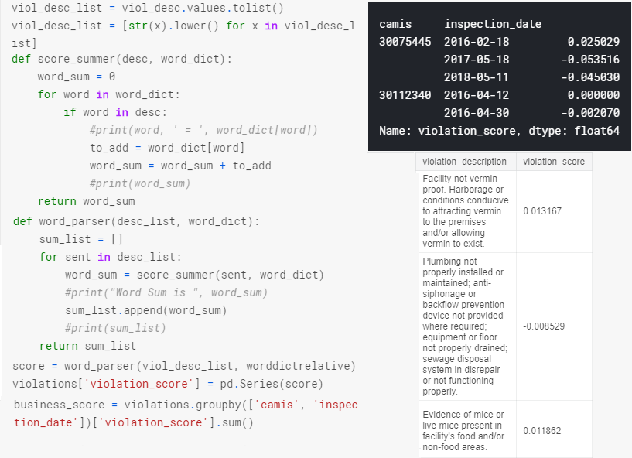
Violation Score
Using the code for the word cloud, which gave each word in the violation description a normalized score, the higher the score the more likely to fail, I wrote a function that would add up each words score and assign a violation score to each description
It was my first attempt to turn the description from categorical data to something the model could interpret and use

Slide 9
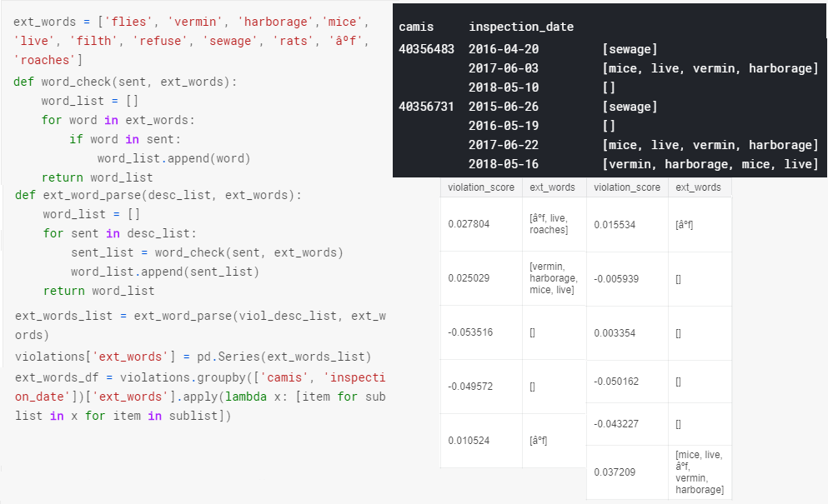
Extreme Words
I noticed that some words lent themselves to failures more often than others and so I made a list of these ‘extreme words’ and used a similar function as used for the violation score to create lists with the extreme words that were found in the descriptions
I had the issue of nested lists because of the multiple violation descriptions for the same days problem and so I had to loop through each and flatten the lists

Slide 10
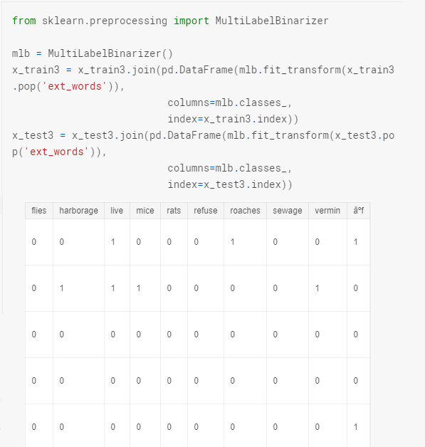
Extreme Words cont.
With a column of categorical data now I decided to go a little more in depth than just summing them up
I used the MultiLabelBinarizer to one hot encode when these words showed up in the description, allowing the model to use and interpret these columns

Slide 11
Conclusion
With the cuisine hit rate category already given to us, and the added violation score and extreme words one hot encoded, the model improved fairly well and was able to predict the probability with a log loss of .19404 from the given .345 or so
It seems that the presence of vermin, mice, rats, and roaches, and mistakes in food storage when it comes to temperature are the most likely reasons to fail an inspection and so I would recommend to any restaurant owner to be on top of these particular violation causes to avoid being shut down

